Slide 1

FinBright Solutions: Empowering Riverwood Through Fintech
A Fintech-Driven Approach to Economic Empowerment
Presented by: The Predictive Minds
Date: March 26, 2025
Notes:
Hello, I’m [Your Name] from [Team The predictive minds. I’m happy to share our plan for FinBright Solutions today. We’re helping Riverwood with RiverBank, which is a simple app to make money skills and banking better for everyone. So, let’s get started and see how we can help this community!"

Slide 2


Problem Statement & Key Insights
Challenges | Opportunities
30% unbanked → High payday loan use | Mobile-first fintech adoption (low smartphone cost)
40% poverty → Limited savings | Microloans + automated savings tools
Mistrust in banks → Low engagement | Community-led ambassadors + local partnerships
Limited financial education | Emerging fintech for low-cost alternatives
Notes:
Let’s start with Riverwood’s story [point to table]. First, we see challenges on the left: 30% of people don’t have bank accounts, so they use expensive loans that cost a lot. Also, 40% are poor, which means they can’t save much money. Many don’t trust banks, so they don’t use them, and there’s not enough learning about money to help them. But on the right, we see hope: lots of people have phones, so we can use an app to reach them. Because of this, small loans and savings tools can make a big difference. Plus, local leaders and partners can help build trust, and new tech can make banking cheap.

Slide 3

Target Audience Segmentation
Focus segment: Banked but Underserved Families (Low-Income Workers, Young Adults, Immigrants)
Needs → "Affordable credit, bill pay, cash access".
Pain Points → "Language barriers, distrust, irregular income, high fees".
Solution Fit → "SMS-based microloans, multilingual app, cash kiosks".
Insights: Prefer cash, high smartphone use, rely on community networks.
Notes:
Now, let’s talk about who we’re helping in Riverwood [point to pie]. We’re focusing on banked but underserved families, which is 70% of the town, mostly Hispanic and African American. This means they have some banking access, but it’s not enough—they include workers, young adults aged 18 to 30, and immigrants. They have clear needs [point to flowchart]: cheaper loans, easy bill payments, and ways to get cash. But they face big problems: some don’t speak English well, they don’t fully trust banks, their income isn’t steady, and fees are too high. So, our app fits them perfectly: we offer small loans by text, an app in English and Spanish, and cash machines at stores. They like using cash, have phones all the time, and trust their community, which makes this plan work well for them."

Slide 4

Solution Design
Onboarding
Language Selection (EN/ES) →ID verification via community partners
Mobile registration → Financial literacy assessment → Open Wallet
Corefeatures
Digital Wallet (no fees) ↔ Microloans (APR 10% vs. payday 400%).
Savings Goals (auto-round-ups) ↔ SMS Alerts (low-balance warnings).
Transactions: Deposit → Payments, transfers, savings → Earn literacy rewards
Offline Access
Cash kiosks at 10 partner stores (e.g., grocery shops).
Tech: Blockchain security, AI coaching.
Notes:
Let me show you our app, RiverBank [point to flowchart]. First, it’s easy to start: you pick English or Spanish, then show your ID through local partners we trust. Next, the app has helpful features for our banked but underserved families: a free wallet to keep your money safe, small loans at 10% interest—much better than 400% from other loans—savings goals that round up your spending to save more, and text alerts if your money gets low. If you don’t have internet, you can use cash machines at 10 stores [point to icon]. The app is safe because it uses special tech, and a smart helper gives you money tips. Here’s the savings screen [point to mockup]. It’s simple and made just for Riverwood’s families."
We can use the following technologie in addition to development to make it uptodate for the current world-→

Slide 5

Financial Literacy Component
Education Roadmap:
Format | Content Example | Delivery
In-App Modules | "Budgeting for Seasonal Work" | Unlock loan discounts
SMS Tips 📱 | "Save $5/week → $260/year!" | Daily/Weekly texts
Workshops | "Avoid Debt Traps" | Festival events
Incentives: Points for milestones, redeemable for discounts.
Notes:
RiverBank also helps people learn about money in a fun way [point to table].
First, inside the app, there are lessons like ‘Budgeting for Seasonal Work,’ -----and when you finish, you get cheaper loans as a reward.
We also send text tips, like ‘Save $5 a week to get $260 a year’ [point to icon], and these come every day or week to keep you on track.
At town festivals, we hold classes on avoiding bad loans, so everyone can join in. Plus, when you learn, you earn points to decrease loan costs. This makes learning easy, helpful, and perfect for Riverwood’s busy families."

Slide 6



Inclusion Strategy & Trust Building
Partnership Ecosystem:
Churches → Trust Workshops
Local Partners
FinBright Solutions
Ambassadors
Credit Unions → FDIC Accounts
Small Businesses → Kiosks
50 trained locals (bilingual)
Notes:
Title---I think this is the key phase , We want everyone in Riverwood to feel included with RiverBank [point to flowchart]. FinBright is at the center, --working with churches to hold classes that build trust, because many banked but underserved families feel safe there. We also team up with credit unions to keep money safe, and with 10 stores to set up cash machines—see them on this map [point to map]. To help even more, we’ll have 50 local helpers who speak English and Spanish or any other languages to guide people. This plan uses Riverwood’s churches, shops, and people, so RiverBank feels like a friend to everyone."

Slide 7
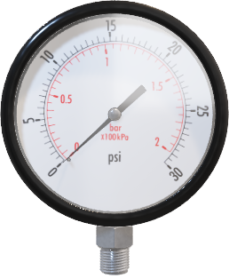
Impact Metrics & Success Evaluation
Category | Metric | Why It Matters
Financial Inclusion📊 | % of unbanked adopting app | Tracks reach to excluded groups
Literacy Improvement📚 | % completing literacy modules | Measures education uptake
Economic Impact💰 | Avg. savings per user | Shows financial stability growth
Engagement | Frequency of app transactions | Indicates trust and usage
Community Feedback📋 | User satisfaction score (surveys) | Ensures solution meets needs
Method: In-app analytics, surveys, partner reports, A/B testing on developed models
Notes:
How will we know if RiverBank is working well? We’ll look at these things [point to table]. First, we’ll check what percent of people without banks start using the app, because that shows we’re helping them. Next, we’ll see how many banked but underserved families finish the learning lessons, so we know they’re gaining skills. Then, we’ll look at how much money people save on average, which helps them feel more secure. We’ll also count how often they use the app for payments—that means they trust it. And finally, we’ll ask people if they’re happy with surveys. We’ll use app data and partner feedback to track all this [point to icons], so we can see the real difference we’re making.

Slide 8
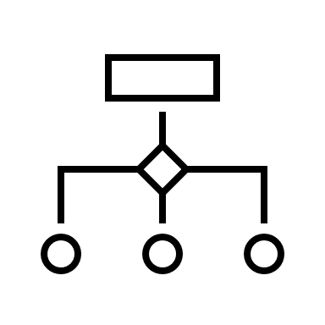
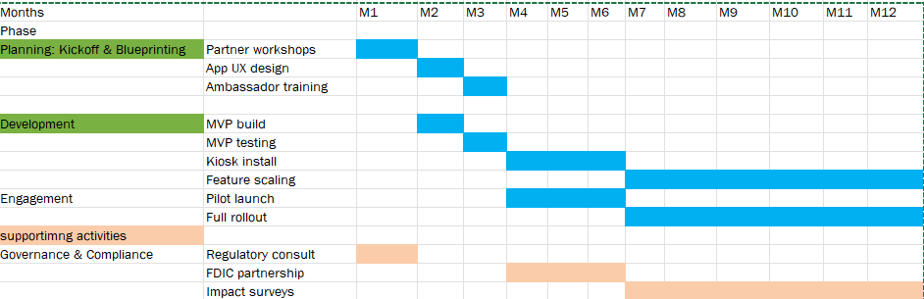
Implementation Plan: High-Level Timeline
Notes:
Now, let’s go through our plan to bring RiverBank to Riverwood [point to chart]. We start in Month 1 by meeting with churches and stores for workshops, and we’ll talk to state regulators to follow the rules. In Month 2, we design the app to make it easy to use. Then, in Month 3, we train 50 local helpers and test the app to make sure it works well. Next, in Months 4 to 6, we set up cash machines at stores, start a small test with users, and work with credit unions to keep money safe—we’ll also check IDs at stores to follow the law. Finally, in Months 7 to 12, we grow bigger, add more features, and ask people how we’re doing with surveys. To make sure everything goes smoothly, we have leaders checking every few months, a team meeting every two weeks, and daily work [point to pyramid]. This plan is careful and fits Riverwood perfectly [point to icon]

Slide 9
Implementation Plan
Partnerships:
Churches for trust workshops (Month 1).
Credit unions for FDIC-insured accounts (Months 4-6).
Small businesses (10 stores) for kiosks (Months 4-6).
Regulatory Strategies:
Consult state fintech regulators (Month 1).
Partner with FDIC-insured credit union for compliance (Months 4-6).
Use store-based KYC for ID verification (Months 4-6).
Governance:
Executive Sponsors (Quarterly): Oversee strategy and funding.
Project Steering (Bi-Weekly): Review progress, resolve issues.
Project Team (Daily): Execute tasks, escalate risks.

Slide 10


Challenges & Risk Mitigation
Risk Mitigation Matrix:
Summary: "RiverBank empowers families with
literacy, inclusion, and savings—tracked by our
metrics."
Risk | Likelihood | Impact | Mitigation
Low adoption | Medium | High | $10 bonus + SMS nudges
Regulatory hurdles | Low | Medium | FDIC bank partnership
Tech outages | Low | High | 24/7 support line
Notes:
Before we wrap up , Let’s talk about how RiverBank is ready to help [point to table]. If not many banked but underserved families use it, which might happen, we’ll give a $10 bonus and send text reminders to encourage them. If rules are tricky, which isn’t too likely, we’ll work with safe banks to follow them. And if the app stops working, which could be a big problem, we have a help line open all day. So, RiverBank helps families learn, join better banking, and save, and we’ll check how well it works with our measures [point to photo]. Our next steps are to test it, make it better, and grow.

Slide 11

Conclusion & Next Steps
Summary:
RiverBank helps banked but underserved families with affordable banking, literacy, and savings. 📱
Community partnerships and a phased rollout ensure inclusion and trust. 🤝
Next Steps: 📅
Start the pilot in Months 4-6 with initial users and local partners.
Use feedback to improve the app and scale to more users in Months 7-12.
Measure impact using our metrics to ensure success.
Notes:
Let’s finish with what RiverBank does and what’s next [point to slide]. RiverBank helps banked but underserved families with affordable banking, learning about money, and saving more. We use community partners and a careful plan to build trust and include everyone. So, what’s next? We’ll start a small test in Months 4 to 6 with our first users and local partners. Then, we’ll use their feedback to make the app better and grow to more people in Months 7 to 12. Finally, we’ll check our success with the measures we shared. This will make a big difference for Riverwood [point to photo]. Thank you so much—any questions?"

Slide 12

Thank You
Contact Information:
The Predictive Minds
rxr230025@utdallas.edu/
Rishi.ravuri99@gmail.com
The University of Texas at Dallas
Q&A

